Slide 1
Better Answer
Ms. Singarajah
7/8A

Slide 2
Its about…. Looking Good & Sounding Smart

Slide 3
It is a process that students can use to help write well organized, good-looking, smart-sounding paragraphs when answering constructed response questions.

Slide 4
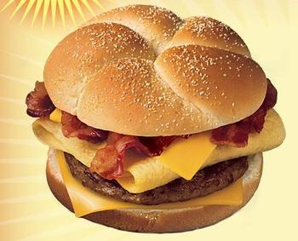
The Better Answer Sandwich
1. Develop an introduction.
• Restate the question.
• Develop a gist answer.
2. Build a body of evidence.
3. Draw a conclusion.

Slide 5
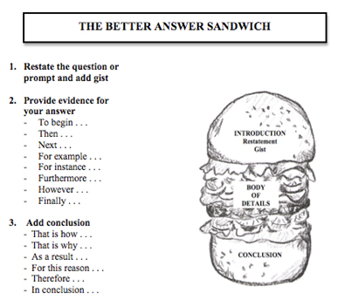

Slide 6
Types of Questions
Informal Questions
Formal Questions
(There’s no need to look good or sound smart.)
• What do you want for supper?
• Where’s the toothpaste?
• Where’d you put my hat?
(Responder needs to look good and sound smart.)
• Job interview: Why do you want this job?
• Test questions: Why didn’t Tom go, too?
• Applications: Explain the details of your plan.

Slide 7
Petitions
Implicit Petitions tell us to
think about . . .
remember . . .
consider . . .
Explicit Petitions tell us to pick up our pencils and
write . . .
describe . . .
tell . . .
explain . . .

Slide 8
Step One: Restating the Question
WHY DO WE NEED TO RESTATE?
Restating makes you sound smart. It helps you focus on what you are being asked.
It is a real world skill, not just a school skill, because people use restating to give themselves another minute to think about the answer and confirm that they really understand what is being asked
It leads to the next step – the answer.
What does it mean to “restate the question?”
Take the question and turn it into a statement.
When we restate the question, we are NOT answering the question!

Slide 9
What did you do yesterday when you got home from school?
This is an example of what we call a known answer question. In other words, we know the answer to this question. But, remember, we don’t want to answer the question, we just want to restate it.
Yesterday when I got home from school I . . . .
Does this restatement answer the question?
Notice that it ends with dot, dot, dot—that means “more to come.”

Slide 10
How is this restatement different?
Yesterday when I got home from school, I did several things.
How is this restatement different from the first one we did?
Do either of these restatements give us specific answers to the question?
Do we know exactly what the person did when he or she got home from school

Slide 11
Two kinds of Restatements
A restatement that ends with . . . . is called an open restatement. Sometimes it may have a transition word before the dots, such as because, by, in, or some other word.
A restatement that ends with a period is called a closed restatement.
Remember, a restatement does not give the answer

Slide 12
Step Two: What is a GIST answer?
A gist answer does not contain important details.
A gist answer states the main idea and can be used as the topic sentence.
A gist answer makes us want to ask, “What do you mean?”
A gist answer provokes us to investigate more.

Slide 13
Why is it important to be on time for school everyday?
• It is important to be on time for school every day because . . .
• An example of a gist answer might be: It is important to be on time for school every day because promptness is a valuable characteristic.
Let’s check our answer: Do I give any important details in this gist answer? Could I use this sentence as the beginning of a paragraph? Could I ask “What do you mean?” What do you mean when you say promptness is a valuable characteristic? Does this gist answer provoke us to investigate more

Slide 14
Step Three: Supporting Details
We are providing the specific details to support our gist answer.
We are actually writing the paragraph that will contain the complete answer to the question.
We are going to make an answer sandwich!

Slide 15
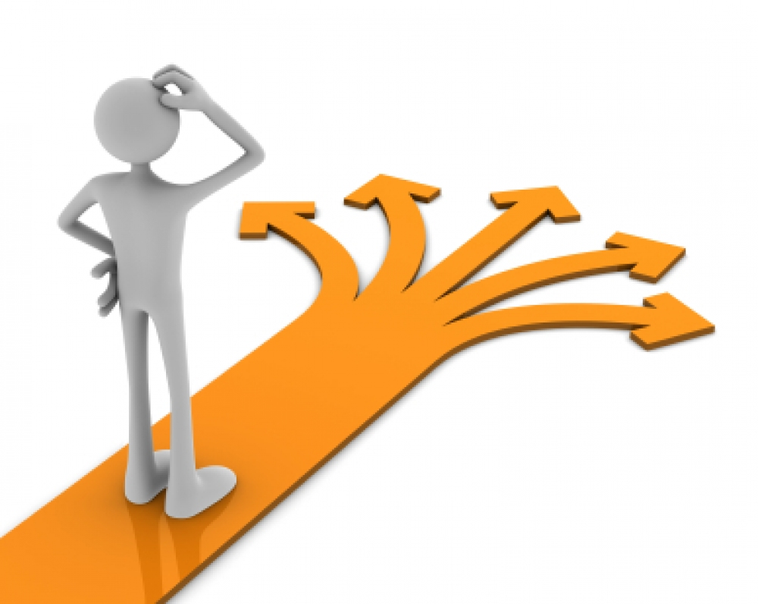
Ordering Details
Chronological Order: the way in which things happened in the article, essay, or story
Order of Importance: either from most important to least important or vice versa
Complex question order: for questions that have several parts, we answer in the order in which they were asked

Slide 16
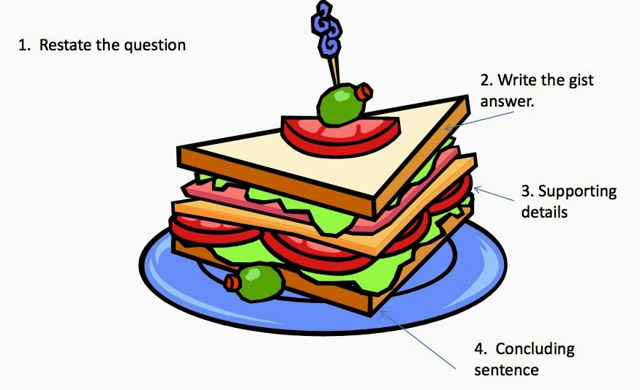
Step Four: Concluding Sentence
Rewording of the introductory sentence
A sentence to wrap up our thinking and conclude our writing piece

Slide 17
EXAMPLE
Yesterday when I got home from school, I had a lot of things to do. First of all, I had to put away the groceries so that my cold items would not ruin. Then, I fed the cat and started the washing machine. My mom called me and I talked to her for a few minutes before I started to cook supper. While the chicken was baking, I put the clothes in the dryer and started grading some papers. When my husband came in, we ate supper, and he helped me clean up the kitchen and put away the clean clothes. Finally, I sat down to watch my favorite television show. I had a lot of things to do, but I got it all done!

